Slide 1
MATERNITY ACTION PLAN
Bridging Gaps in Care
January 28, 2025

Slide 2
AGENDA
AGENDA
12:00PM – 12:05PM Welcome & Overview of the Day
12:05PM – 12:25PM Navigating the Obstacles: The Complex Journey of Perinatal Care in New Jersey- presented by Kate Shamszad, New Jersey Health Care Quality Institute
12:25PM – 12:35PM Q&A with Kate
12:35PM – 1:20PM Panel Discussion: How gaps are being addressed and what more is needed to address challenges in care for reproductive health and across the perinatal period.
1:20PM – 1:30PM Q&A with Panel
1:30PM – 1:50PM Group Discussion: Bridging Gaps in Care
1:50PM – 2:00PM Closing Remarks from the Quality Institute
Notes:
Good afternoon, welcome to the New Jersey Health Care Quality Institute’s Maternity Action Plan Work Session. My name is Kate Shamszad and I am the director of Policy with the Quality Institute. Before we dive into the agenda, I want to thank you all for dedication to improving birth equity in New Jersey, and for our out-of-state attendees, across the nation. During today’s work session, we will give you a brief overview of the Maternity Action Plan and our newest report. Then we will transition to hearing from our subject matter experts. We’ll come back together to have a group discussion and close out for the afternoon.
Before we get into the content, I want to go over some housekeeping items to ensure a smooth session. Please note that this meeting is being recorded and will be available on our website. We have enabled Zoom’s ai Companion, which is our virtual assistant that can provide you real-time transcription or a summary of key points from today’s meeting. Kindly keep your microphone muted when you're not speaking to minimize background noise. This will contribute to a more focused and productive environment.
As we navigate through the agenda, feel free to step away if needed as we do not have any built-in breaks. Please feel free to leave any comments or questions in the general chat. You can also hold your questions for our brief Q&A and raise your hand to ask them during these sections. If you have any technology issues, please send a message in the chat, or directly message Vanessa Gibbs.

Slide 3
THE REPORT
In partnership with many partners and advocates, the Quality Institute created the MAP to provide a directional path forward to address New Jersey’s maternal health crisis. The MAP outlines four priorities to improve Maternal Infant Health, address racial disparities and promote equitable care and outcomes. 1. Building the Maternal Workforce Needed to Achieve Birth Equity and Quality 2. Collecting and Using Data to Improve Equity and Quality 3. Reforming Payment Systems to Drive High Quality Holistic Maternal Infant Health Care 4. Improving Community-Based Social Supports
Notes:
New Jersey Health Care Quality Institute, in partnership with many organizations and individuals across New Jersey, created and released the Maternity Action Plan which is well known as the MAP, in July 2022. The MAP is a holistic approach to making New Jersey the safest place in the nation to give birth and raise a child. The MAP provides a directional path forward in four critical areas:
Building the Maternal Workforce
Collecting and Using Data
Reforming Payment Systems
Improving Community-Based Social Supports

Slide 4
MAP EVOLUTION
MAP Resources Feedback on the MAP report and input from MAP to Action Work Sessions was used to create the Maternal Infant Health Values which ground all the work.
Maternal Infant Health Values
Breaking down systemic racism
Centering lived experience
Creating structures for accountability
Developing trust across the system
Creating authentic hope for improvement
Building transparency into systems
Notes:
In 2023, we launched "MAP to Action." Like today's session, we hosted virtual work sessions for each MAP section, featuring subject matter experts from various sectors, including healthcare, law, community organizations, and government. For recordings and resources from our work session series, visit our website or scan the QR code on this slide.
We have held two in-person convenings to foster networking and collaboration amongst our virtual attendees. Our planning for the first convening was shaped by conversations from virtual sessions, leading to the creation of six maternal-infant health values (shown on the right). These values were central to our discussions and continue to guide the Maternity Action Plan work. We will also be hosting two additional virtual work sessions in 2025. We hope we can all continue to work together toward the common goal of optimal maternal child health in New Jersey.

Slide 5
NAVIGATING THE OBSTACLES:
The Complex Journey of Perinatal Care in New Jersey

Slide 6
About the Quality Institute
About the New Jersey Health Care Quality Institute
The New Jersey Health Care Quality Institute (Quality Institute) is a non-profit organization focused on improving the safety, quality, and affordability of health care for everyone. Our work includes increasing access to quality reproductive health services, including contraceptive and perinatal care.
Acknowledgments
The Quality Institute thanks the Community Health Acceleration Project (CHAP), NJ Birth Equity Funders Alliance (NJBEFA), and the Community Foundation of New Jersey (CFNJ) for generously funding this project.
Notes:
With that we will transition into our first presentation of the day. We are highlighting a recently released report from the Quality Institute. Thank you for joining me today as we discuss ‘Navigating the Obstacles: The Complex Journey of Perinatal Care in New Jersey. This report examines coverage gaps and disparities across state-regulated and state-funded insurance programs, highlighting their impact on maternal and infant health outcomes and explores the barriers pregnant individuals face in accessing equitable, high-quality care.
Through patient journeys and data analysis, the report illustrates how coverage of behavioral health, postpartum care, and social supports create challenges for families. It offers actionable policy recommendations to promote equity, expand access, and improve care for all families in New Jersey.
We are grateful to our funders—the Community Health Acceleration Project, NJ Birth Equity Funders Alliance, and the Community Foundation of New Jersey—for supporting this research and the report.

Slide 7
High-quality perinatal care is critical for maternal and infant health outcomes.
•Assess Existing Coverage Policies: Examine perinatal care
coverage policies across state-regulated and publicly-funded insurance markets.
•Identify Gaps and Disparities: Highlight gaps and disparities
in perinatal care coverage.
•Recommend Policy Improvements: Propose policy changes
to improve access and equity in perinatal care.
3
Notes:
The goal of this project is to access to high-quality perinatal care for everyone, which is critical for improving maternal and infant health outcomes. Today, we'll explore three key objectives:
Assessing existing coverage policies for perinatal care.
Identifying gaps and disparities across state-regulated and publicly funded healthcare coverage. And
Recommending policy improvements to enhance access and equity.

Slide 8
In New Jersey, the perinatal care coverage provided by state- regulated insurance plans and state-funded health coverage varies significantly.
Prenatal | Birth | Post-Partum
Mental Health | Health Related Social Needs | Dental
Reproductive Assistance | Drugs | Contraception
4
Notes:
In New Jersey, the scope of perinatal care coverage varies significantly between state-regulated insurance and public health coverage. Key gaps exist in drug benefits, behavioral health services, dental care, and social support benefits such as transportation. For example, while NJ FamilyCare offers comprehensive coverage, programs like the NJ Supplemental Prenatal and Contraceptive Program (SPCP) provide only limited benefits, with critical gaps in care.

Slide 9
Pathways for Medicaid Enrollment
PRESUMPTIVE ELIGIBILITY
Presumptive eligibility (PE) for Medicaid is a policy that allows individuals to receive immediate, temporary Medicaid coverage while their full application is being processed.
This temporary coverage is provided as part of NJ FamilyCare FFS. This policy is designed to provide quick access to health care services for individuals who appear to be eligible based on preliminary information. Here’s how it works:
APPLYING FOR NJ FAMILYCARE
A pregnant person can apply for NJ FamilyCare, which is New Jersey’s state Medicaid program, in the following ways:
1. Online: NJ FamilyCare website.
2. By Phone: NJ FamilyCare hotline
3. In-Person: County Welfare Agency (CWA)
4. By Mail
After enrollment, select one of five Medicaid managed care organizations (MCOs) that will administer the NJ FamilyCare benefit.
Notes:
Let's take a closer look at pathways for enrolling in NJ FamilyCare, New Jersey's Medicaid program. In the state, approximately 1/3 of pregnancies and deliveries are covered under Medicaid.
There are a number of enrollment pathways, with applications accessible through online applications, phone, mail, or in-person visits to County Welfare Agencies.
Pregnant individuals can also benefit from presumptive eligibility, which allows for immediate temporary coverage, paid through the state’s Medicaid Fee For Service program while their application is being processed. This ensures timely access to care, particularly for those in urgent need like accessing care during the prenatal period. It is essential that a full application is completed, however, because presumptive eligibility only provided care for a short time frame and full enrollment is needed particularly to enroll in a Medicaid managed care organization.

Slide 10
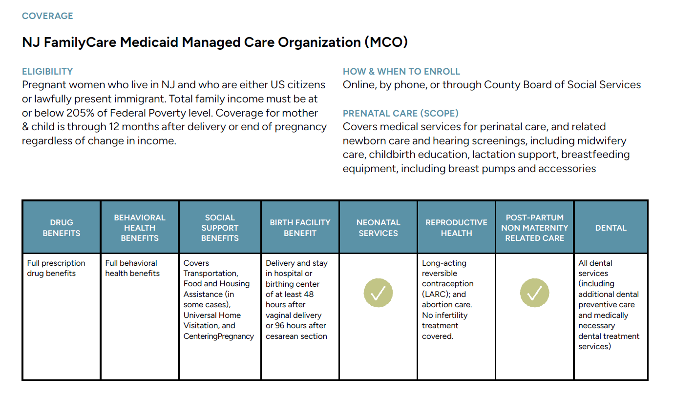
Notes:
For each of the insurance types explored and highlighted in this report, we created an overview of the coverage offered. This slide shows the NJ FamilyCare Medicaid Managed Care Organizations (MCOs) coverage. NJ FamilyCare covers pregnant women who live in New Jersey, are either U.S. citizens or lawfully present immigrants, and have a total family income at or below 205% of the Federal Poverty Level.
Importantly, coverage extends to both the mother and child for 12 months after delivery or the end of pregnancy, regardless of income changes.
Once enrolled, beneficiaries receive comprehensive prenatal care, which includes medical services for both the individual and their newborn, midwifery care, childbirth education, lactation support, and breastfeeding equipment.
The benefits provided are extensive, addressing key areas like:
Drug Benefits: Full prescription drug coverage.
Behavioral Health: Comprehensive mental health services.
Social Support: Programs like transportation assistance, food support, Universal Home Visitation, and CenteringPregnancy.
Birth Facility Benefits: Coverage for hospital or birthing center stays of at least 48 hours after vaginal delivery or 96 hours after a cesarean section.
Reproductive Health: Access to long-acting reversible contraception (LARC) and abortion care.
Postpartum Non-Maternity Related Care: Support for health services beyond pregnancy-specific needs.
Dental Services: All dental care, including preventive and medically necessary treatments

Slide 11
Enrolling in the NJ Supplemental Prenatal and Contraceptive Program
The NJ Supplemental Prenatal and Contraceptive Program (SPCP) provides limited benefits focusing mainly on outpatient prenatal and family planning services. SPCP does not cover the cost of labor and delivery. This cost is paid for via the Medical Emergency Payment Program (MEPP).
6
Notes:
In contrast to NJ FamilyCare, let’s examine the NJ Supplemental Prenatal and Contraceptive Program, or SPCP. This fully state-funded program is designed to offer limited benefits focused on outpatient prenatal and family planning services for individuals who don’t qualify for broader Medicaid coverage because of their immigration status. Of note, while we generally use non-gendered language when discussing pregnancy, the SPCP program specifically uses “women” to describe eligibility for the program so that is used in the report and on this slide.
The program is designed for women ages 19 to 64 who are NJ residents with incomes up to 205% of the Federal Poverty Level but are ineligible for NJ FamilyCare due to immigration status. Notably, women under 19 who are pregnant can instead enroll in the Cover All Kids program, which provides the same full benefits as NJ FamilyCare.
Enrollment in SPCP is available through a provider’s office, clinic, or hospital using the presumptive eligibility process. This allows for temporary coverage while eligibility is formally processed, ensuring timely access to critical prenatal services.
SPCP provides immediate, temporary coverage under its presumptive eligibility process, allowing individuals to access prenatal and contraceptive services without delay. Temporary coverage remains in place while full eligibility is determined, which can take some time. SPCP is a critical pathway to care, especially for non-residents and individuals ineligible for full Medicaid due to immigration status.

Slide 12
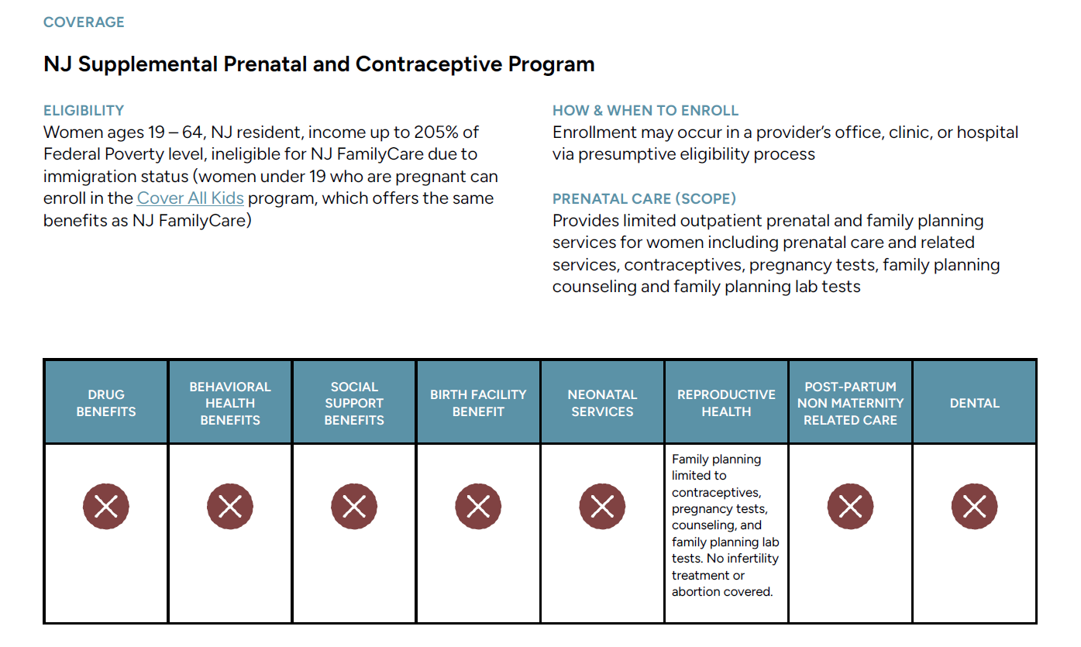
Notes:
However, SPCP benefits are limited in scope. The program focuses on outpatient prenatal and family planning services, including contraceptives, pregnancy tests, family planning counseling, and lab tests. There are significant exclusions:
No drug benefits, meaning essential medications for pregnancy-related conditions must be paid for out-of-pocket.
No behavioral health benefits, leaving mental health needs unaddressed.
No social support benefits, such as transportation or food assistance.
No birth facility or neonatal care benefits, with labor and delivery costs instead covered by the Medical Emergency Payment Program (MEPP).
No postpartum or dental care, creating gaps in critical follow-up services.
SPCP’s limited scope leaves significant gaps in care for underserved populations, particularly those who require more comprehensive services. Addressing these limitations is essential to improving equitable access to perinatal care in New Jersey.

Slide 13
Anna’s Journey Through Perinatal Care: Medicaid Coverage
Anna is excited and anxious about her pregnancy.
She is an NJ FamilyCare member, enrolled in a Managed Care Organization (MCO), and has been receiving primary and preventative care.
When she learns that she is pregnant, she calls the closest clinic to her home that provides pregnancy care for those with NJ FamilyCare.
Throughout her pregnancy, she experience challenges that impact her care and experience.
Notes:
To understand the real-world impact of these coverage gaps, we illustrated the care journeys of three patients—Anna, Sarah, and Amanda—each navigating the perinatal care system with different types of insurance.
Anna, enrolled in NJ FamilyCare, began her pregnancy excited yet anxious. She experienced delays in accessing her first in-person prenatal appointment due to high demand and limited clinic capacity so her first appointment was via telephone triage. Transportation challenges also arose, as Medicaid transportation services were required for appointments at multiple clinic locations.
Anna wanted the support of a doula but struggled to find one reimbursed by NJ FamilyCare. Many doulas she contacted were either ineligible for reimbursement due to restrictive credentialing policies or unable to afford providing services at Medicaid’s low rates. Later in her pregnancy, Anna was diagnosed with severe gestational diabetes, but delays in obtaining medical approvals for necessary medicine from her Managed Care Organization prolonged time to treatment.
At delivery, Anna requested immediate postpartum contraception, but her hospital did not stock IUDs for NJ FamilyCare patients, leaving her without the desired method of contraception. Anna’s story demonstrates persistent barriers in Medicaid services, from delayed care to limited access to postpartum and doula support.

Slide 14
Sarah’s Journey Through Perinatal Care:
NJ Supplemental Prenatal and Contraceptive Plan Coverage
Sarah, an expectant mother who lives in New Jersey but does not have US residency, began her perinatal journey at Federally Qualified Health Center (FQHC).
She seeks prenatal care with the hope of receiving comprehensive and timely medical support for her pregnancy.
However, Sarah soon found herself navigating a complex and often frustrating healthcare system.
Notes:
Sarah began her perinatal care journey at a Federally Qualified Health Center (FQHC) after learning she might qualify for the NJ Supplemental Prenatal and Contraceptive Program (SPCP). As a non-U.S. resident, Sarah was ineligible for broader Medicaid coverage, leaving her reliant on SPCP’s limited benefits.
Her journey started with a phone intake at the FQHC, where a clinic specialist completed her presumptive eligibility application for SPCP. However, delays in processing meant it took weeks for Sarah to receive her Medicaid ID, which was required to schedule her first-trimester ultrasound. This delay created stress and limited her access to critical early prenatal care.
Throughout her pregnancy, Sarah struggled with transportation challenges. As SPCP does not cover travel support, Sarah relied on family members for rides to the Maternal Fetal Medicine (MFM) clinic where she needed specialized care. This dependency often delayed appointments and added strain to her already complex care process.
During her pregnancy, Sarah was diagnosed with pre-eclampsia, a condition requiring medication to manage her blood pressure. Unfortunately, SPCP does not cover prescription drugs, forcing Sarah to pay for the medication out-of-pocket—a significant financial burden for her. Despite her efforts to manage her condition, the lack of comprehensive coverage heightened her stress.
When Sarah gave birth at 39 weeks, the delivery costs were paid for by the Medical Emergency Payment Program (MEPP), as SPCP does not cover labor and delivery. Sarah had previously expressed interest in getting the Nexplanon contraceptive implant before being discharged, but because SPCP does not integrate postpartum and delivery care seamlessly, she had to return to the FQHC for family planning services after being discharged.
After delivery, Sarah’s challenges continued. Her SPCP coverage ended with her pregnancy, leaving her without postpartum benefits such as lactation support or mental health services. When a pediatrician noticed signs of postpartum depression, Sarah was referred to a nonprofit organization that provided mental health care on a charity basis, as SPCP does not include behavioral health benefits. The fragmented system left Sarah to navigate complex care transitions with minimal support.
Her baby qualified for NJ FamilyCare after birth, but Sarah’s out-of-pocket postpartum expenses and the lack of continuity in care underscore the critical need for expanded benefits under SPCP to address postpartum health and mental well-being.

Slide 15
Amanda’s Journey Through Perinatal Care
NJ Commercial Insurance- Individual Marketplace Coverage
Amanda, a resident of New Jersey, is excited about her pregnancy but faces significant challenges related to her insurance coverage and health care costs.
Amanda purchases her commercial insurance through New Jersey's individual marketplace, GetCoveredNJ.
While the subsidies she receives keep her monthly insurance premium low, the high cost-sharing aspects of her plan present numerous hurdles during and after her pregnancy.
Notes:
Amanda is a New Jersey resident who purchased commercial insurance through the GetCoveredNJ marketplace. She faced a challenging and stressful perinatal journey due to financial barriers and limited coverage.
Although subsidies helped lower her monthly premiums, Amanda’s high-deductible plan left her worried about out-of-pocket expenses for essential prenatal and delivery care.
At her first prenatal appointment, Amanda’s provider did not conduct a Perinatal Risk Assessment—a tool required for Medicaid patients to identify social, financial, and behavioral needs. This meant her anxiety about the financial and emotional demands of pregnancy went unnoticed and unaddressed.
Amanda hoped to work with a doula for support during pregnancy and childbirth, but her insurance plan did not cover doula services. After contacting a few local doulas, she realized the cost was out of reach for her budget, leaving her without the additional guidance and advocacy she had hoped for.
In her second trimester, Amanda experienced a severe anxiety attack, leading to an emergency room visit. While the ER visit provided immediate care, the high copay left her financially strained. She was referred to community mental health services to manage her anxiety, but the ongoing costs of therapy sessions were prohibitively expensive under her insurance plan. As a result, Amanda had to forgo professional mental health care, compounding her stress and worry as her pregnancy progressed.
As Amanda prepared for delivery, her anxiety intensified due to the anticipated costs of childbirth under her high-deductible plan. She reached out to her hospital to discuss payment plans and financial assistance options. Although the hospital offered resources and support, the structural limitations of her insurance plan meant Amanda still faced significant out-of-pocket expenses.
Despite these challenges, Amanda was able to access timely prenatal checkups, necessary screenings, and childbirth education classes covered by her plan.
After delivery, Amanda added her baby to her insurance as a qualifying “life change” event, ensuring coverage for her newborn. However, the financial and emotional toll of her journey underscores the need for more comprehensive insurance benefits and lower cost-sharing to support families during the perinatal period.

Slide 16
Policy Recommendations
Expand Coverage for the Supplemental Prenatal and Contraceptive Program:
Prescription Drug Benefits for Pregnancy-Related Conditions: Include full prescription drug benefits to cover medications essential for prenatal care and managing pregnancy-related conditions.
Behavioral Health Services: Incorporate comprehensive behavioral health benefits to address mental health needs during and after pregnancy.
Dental Coverage: Ensure comprehensive dental services for pregnant women, including preventive care, treatment of pregnancy-related dental conditions, and coverage for medically necessary dental procedures.
Social Needs Benefits: Extend coverage to include services that address social determinants of health, such as transportation assistance.
Post-Partum Care: Provide comprehensive post-partum care, including a post-partum visit, to support the health and well-being of birthing people beyond childbirth.
Notes:
Amongst our recommendations, there are key policy changes that would improve the Supplemental Prenatal and Contraceptive Program (SPCP), which currently offers only limited benefits to pregnant individuals in New Jersey. These recommendations aim to close critical gaps and ensure equitable access to comprehensive perinatal care.
Prescription Drug Benefits for Pregnancy-Related Conditions: The SPCP should include full prescription drug coverage to address essential medications for prenatal care and managing pregnancy-related conditions. This change would help patients manage chronic or acute conditions without the financial burden of out-of-pocket expenses.
Behavioral Health Services: Comprehensive behavioral health benefits are essential to address mental health needs during and after pregnancy. This would support individuals facing conditions like postpartum depression or anxiety, ensuring they can access timely care.
Dental Coverage: Oral health is a critical component of maternal and infant health. Expanding SPCP to include preventive dental care, treatment for pregnancy-related conditions, and medically necessary dental procedures would help address an often-overlooked aspect of perinatal care.
Social Needs Benefits: Many pregnant individuals face challenges related to social determinants of health, such as transportation or housing insecurity. Including services to address these needs, like transportation assistance, would ensure better access to care and reduce barriers to timely appointments.
Postpartum Care: Finally, SPCP should include comprehensive postpartum services, such as follow-up visits and continued care for both physical and mental health after childbirth. This ensures birthing individuals receive the support they need beyond delivery, promoting long-term health and well-being.
Together, these recommendations represent a roadmap to making SPCP more equitable and effective, addressing the full spectrum of care required for healthy pregnancies and better outcomes for families.

Slide 17
Policy Recommendations
Increase Access to Doula Services:
Standardize Coverage: Mandate doula services coverage across all state-regulated insurance products
Funding and Training: Allocate funding for the training to ensure sufficient supply of qualified professionals. Broaden training requirements to allow for a wider range of education to be able to be credentialed and reimbursed.
Enhance Dental Care Awareness:
Outreach: Implement education and outreach programs for perinatal care providers and pregnant people to raise awareness about importance of oral health during pregnancy and impact on overall maternal and infant health.
Standardize Access and Coverage of Behavioral Health:
Uniform Benefits: Ensure consistent coverage of behavioral health services across all state-regulated insurance programs.
Integrated Care Models: Promote integrated care models that combine medical, behavioral, and social services to provide holistic care.
Improve Post-Partum Coverage:
Comprehensive Care: Coordinate post-partum care pathways to ensure access to a full range of health services beyond maternity-related care, including integrated mental health support, chronic disease management, and preventative screenings.
Notes:
Additional policy recommendations to address key gaps include
Increase Access to Doula Services:
Standardize Coverage: Doula services are proven to improve maternal health outcomes and provide critical support during pregnancy and childbirth. Mandating coverage across all state-regulated insurance plans would ensure equitable access.
Funding and Training: Expanding doula availability requires funding for training programs to increase the supply of qualified doulas. Broader training requirements should allow individuals with diverse educational backgrounds and experience to be credentialed and reimbursed.
Enhance Dental Care Awareness:
Outreach: Education and outreach programs are essential to raise awareness among perinatal care providers and pregnant individuals about the importance of oral health during pregnancy. Poor oral health can affect maternal and infant outcomes, making dental care a key component of comprehensive perinatal care.
Standardize Access and Coverage of Behavioral Health:
Uniform Benefits: Behavioral health services should be consistently covered across all state-regulated insurance programs to address mental health challenges like postpartum depression or anxiety.
Integrated Care Models: Promoting integrated care models that combine medical, behavioral, and social services will create a holistic approach to perinatal care and improve overall health outcomes.
Improve Postpartum Coverage:
Comprehensive Care: Coordinating postpartum care pathways is essential to ensure access to a wide range of services beyond maternity care. This includes mental health support, chronic disease management, and preventive screenings to support long-term health and well-being.

Slide 18
Enhancing perinatal care coverage in New Jersey requires addressing the existing gaps and disparities across insurance markets and state-funded coverage.
By implementing policy change, the state can improve access to comprehensive perinatal care, promote maternal and infant health, and advance birth equity.
These efforts will ensure that all pregnant individuals receive the support and care they need for a healthy pregnancy and post-partum period.
Notes:
Closing the gaps in perinatal care coverage are essential to improving maternal and infant health and advancing birth equity in New Jersey. With targeted policy changes, the state can ensure all pregnant individuals have access to the comprehensive care and support needed for healthy pregnancies and postpartum.

